Slide 1
Assessment Task 5 Feedback
3/5/2017

Slide 2
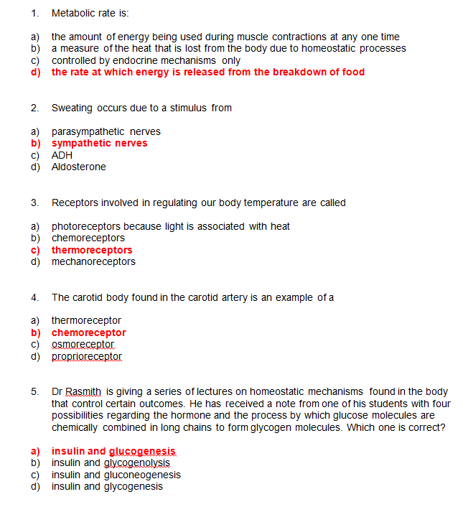

Slide 3
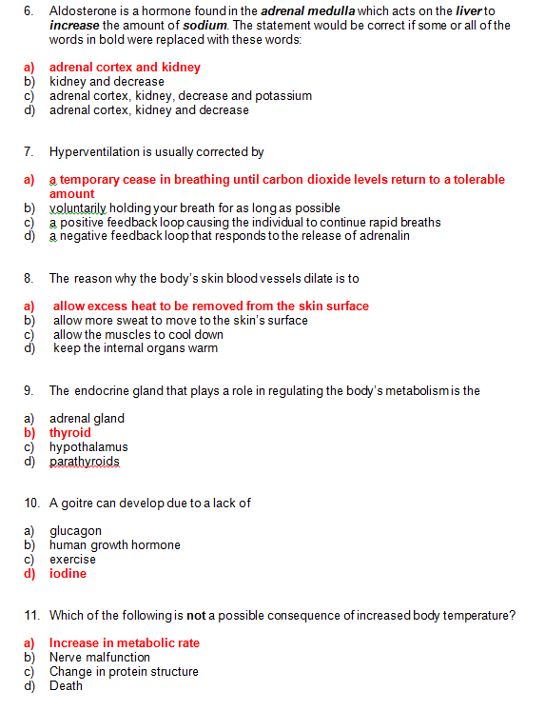

Slide 4
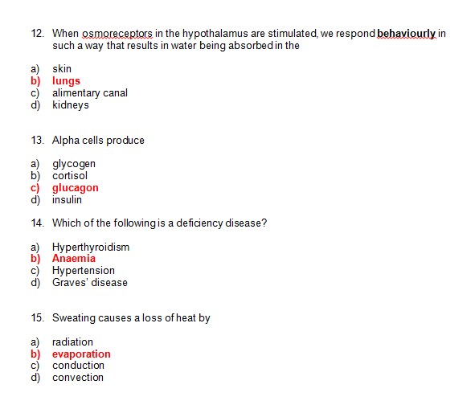

Slide 5
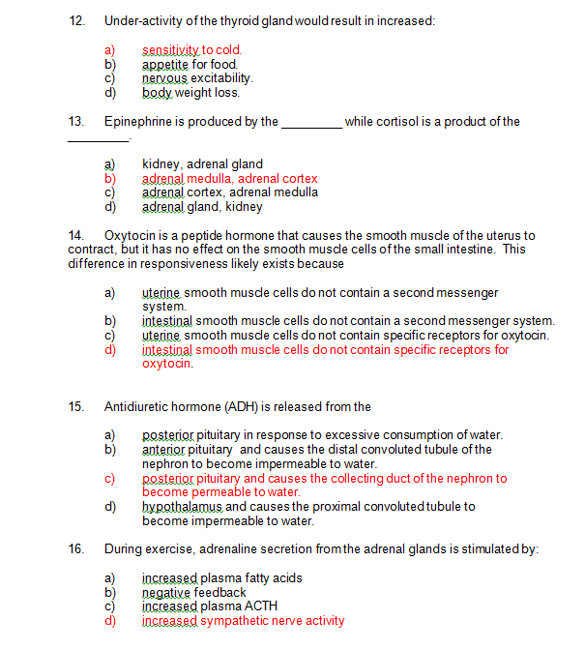

Slide 6
Notes
5- Comprehension
11-?
12- Revision

Slide 7
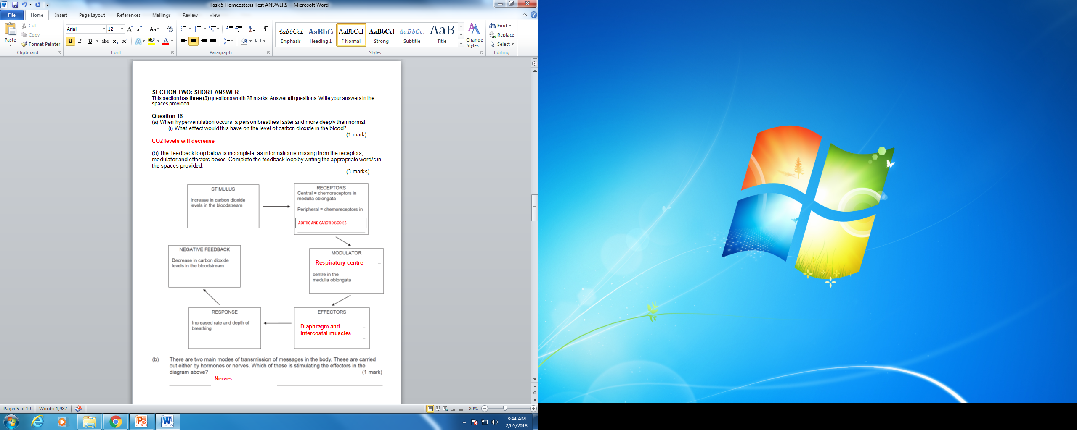
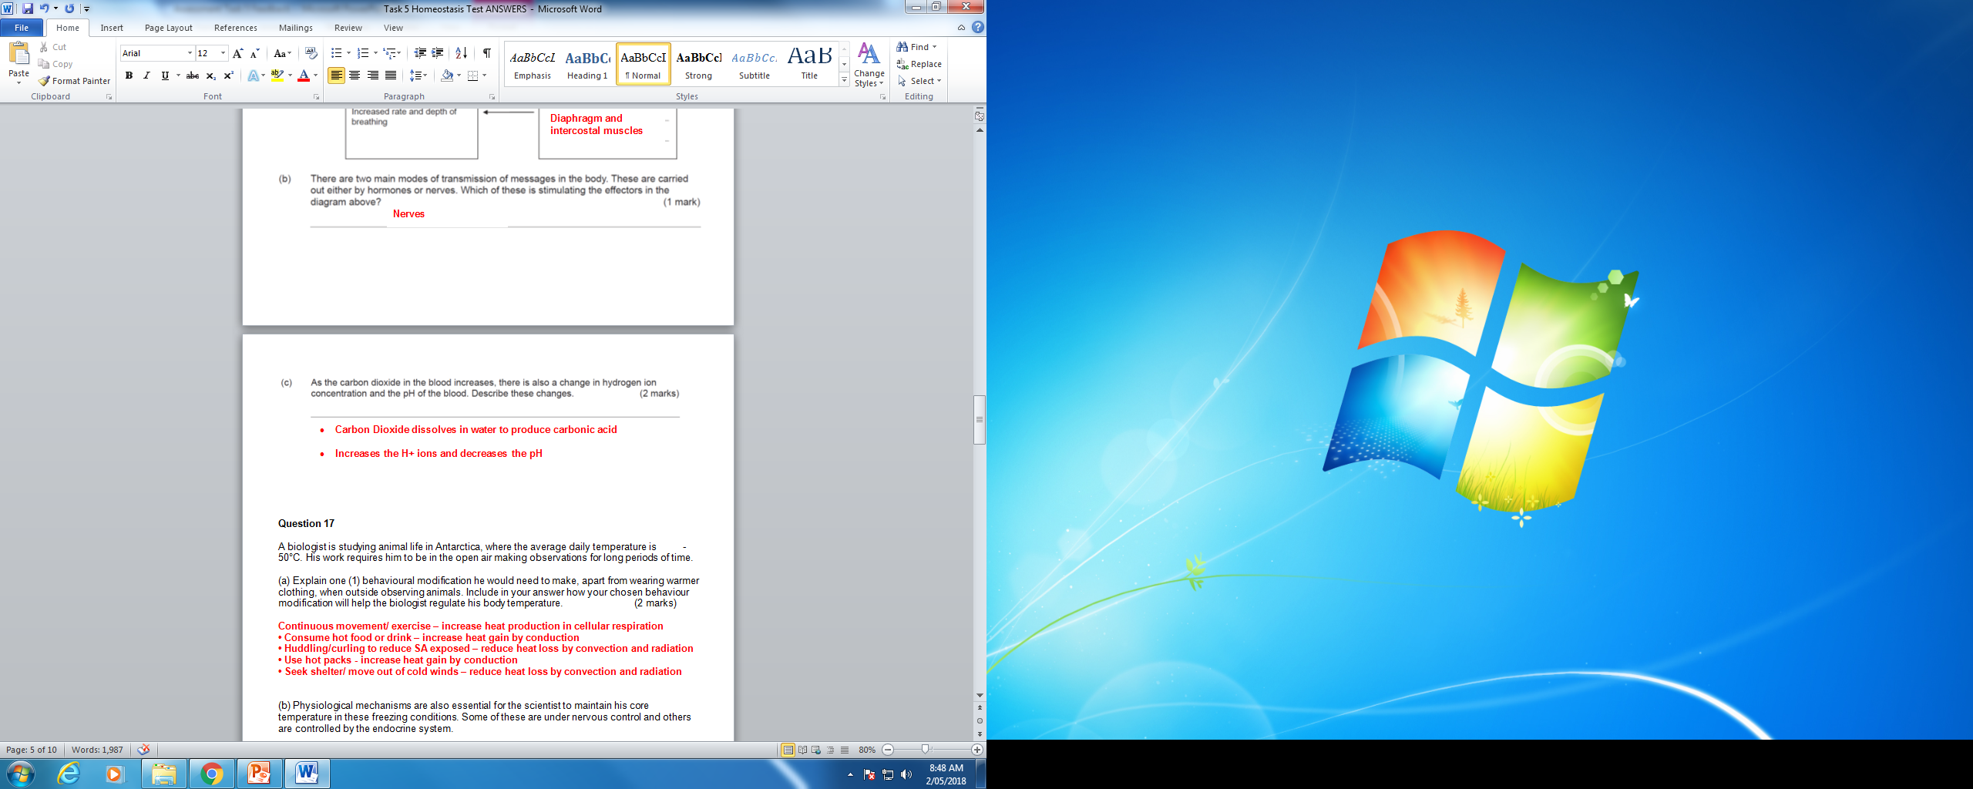

Slide 8
16a i) Some confusion but mostly done well.
A ii) Mostly done well
B) All good
C) Mostly done well

Slide 9
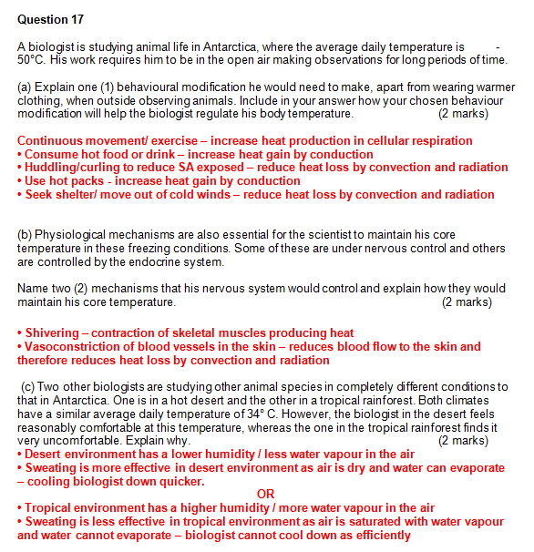

Slide 10
Notes
17a) Mostly okay with this (some missed behavioural modification)
B) Done well mostly
C) Done well mostly

Slide 11
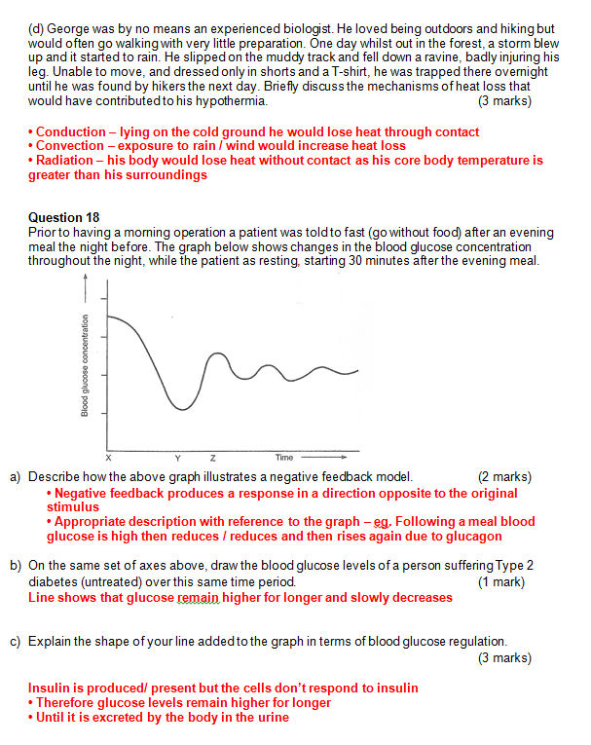

Slide 12
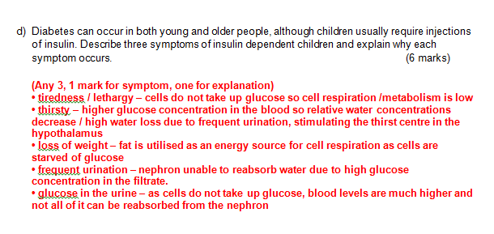

Slide 13
Notes
17d) Not done well and tricky question. Looking for loss of heat due to contact with ground, exposure to rain/wind and radiation. Most answers not clear.
18a)- Most able to describe glucose levels going up and down but not clearly linking to idea of stimulus being counteracted.
B)-Line not exact. Some people got basic shape but not done well.
C)- Most people got 1or 2 out of first two points. No one mentioned third point- allowed removed via respiration.
D) –Not done well, wrong symptoms or lack of correct explanation.

Slide 14
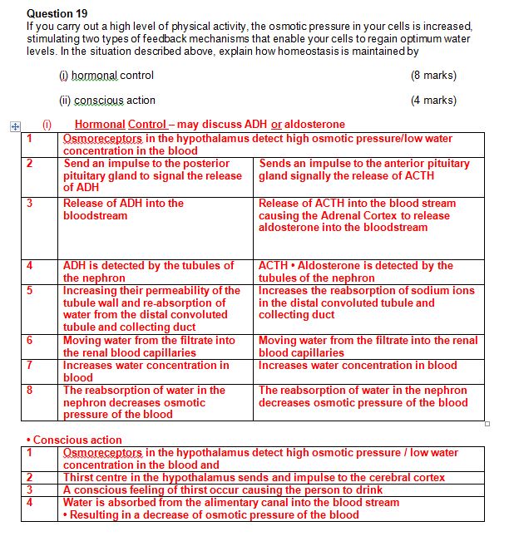

Slide 15
Notes
Was a negative feedback loop but required more detail.
Most people were able to identify that and the content needed.
Most just needed MORE precise detail e.g. The nephrons in tubule, water is reabsorbed from the filtrate into capillaries

Slide 16
To do..
Areas of strengths
Areas to improve

Slide 17
What’s next…
One more test for Immune System
Then EXAM!!!!
Now is the time to be revising your assessments and identifying individual sections you need to improve
Work out how to improve these
Ask me
Revise content
Revisit how you are learning/revising this information.
How to learn faster: https://www.youtube.com/watch?v=B9SptdjpJBQ
Study Tips based on studies: https://www.youtube.com/watch?v=p60rN9JEapg
Exam Anxiety: https://www.youtube.com/watch?v=FyBdA61GmJ0

